Slide 1
Week 9 Lab Agenda
Part A
Question 1, 2 & 3 (Questions similar to Lab-8)
Part B :
Question 4 & 5

Slide 2


Joint Probability Notation
P(A ∩ B) can also be expressed as P(A,B)
Probability of Event A & B happened at the same time.
Probability that It Rain AND Sky is Dark
A = Rain
B = Sky is dark

Slide 3




Conditional Probability Notation
P(A | B)
Can be expressed as:
The probability that event A happens given that event B has already occurred
The probability that It Rain given that the Sky is Dark
Event B already happened/given
A = Rain
B = Sky is dark

Slide 4






1) How to calculate Joint Probability
1) Determine the joint probability of P(A , B)
P(A , B) = P(B | A) * P(A)
= 0.50 * 0.20
= 0.10
P(A , B) = P(A) * P(B | A)
= 0.20 * 0.50
= 0.10
Given (Random value):
P(A) = 0.20
P(B|A) = 0.50

Slide 5




1) Joint Probability, Bayesian network (Continue..)
P(A, B, C, D) = P(A) * P(B | A) * P( C | B ) * P( D | B )
References: Lecture 9 – Slide 11

Slide 6






2) How to calculate Probability of an event (Marginal Probability)
1) Calculate P(B)
Given Joint Probability (Example with Random value):
P(A,B) = 0.10
P(A,B’) = 0.20
P(A’,B) = 0.30
P(A’,B’) = 0.30
P(B) = P(A,B) + P(A’,B)
= 0.10 + 0.30
= 0.40

Slide 7
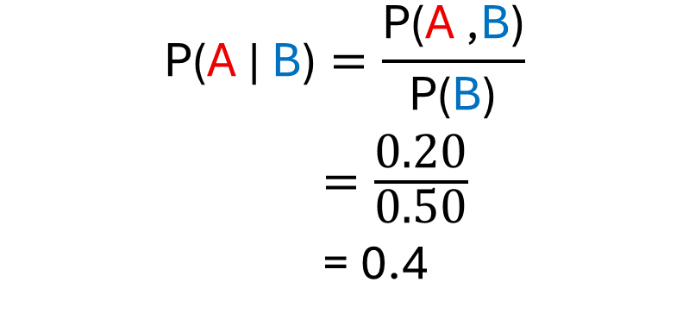


3) How to calculate Posterior Probability
1) Find posterior probability of P(A | B)
Given Information (Example with Random value):
P(B) = 0.50
P(A,B) = 0.20
$$\text{P}\text{(}\text{A}\text{ | }\text{B}\text{)}=\frac{\text{P}\text{(}\text{A} \text{,}\text{B}\text{)}}{\text{P}\text{(}\text{B}\text{)}}$$
$=\frac{\text{0.20}}{\text{0.50}}$
= 0.4

Slide 8
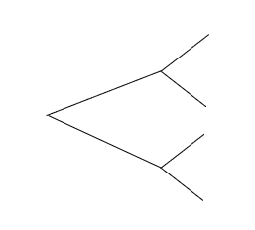



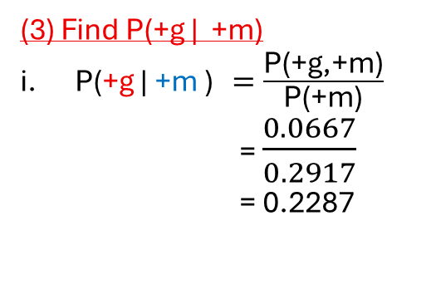


Part-A
Step:
Extract Relevant Information from question
Draw tree representation
Given Info:
(1) Joint Probability over G & M
P(+g, +m) = P(+m | +g ) * (+g)
= 0.667 * 0.10
= 0.0667
P(+g, -m) = P(-m | +g ) * (+g)
= 0.333 * 0.10
= 0.0333
P(-g, +m) = P(+m | -g) * (-g)
= 0.25 * 0.90
= 0.225
P(-g, -m ) = P(-m | -g) * (-g)
= 0.75 * 0.90
= 0.675
(2) What is P(+m)
P(+m) = P(+g, +m) + P(-g, +m)
= 0.0667 + 0.225
= 0.2917
Let:
P(+g) = 0.10, P(-g)=0.90
P(+m | +g) = 0.667
P(-m | +g) = 0.333
P(+m | -g) = 0.25
P(-m | -g) = 0.75
(3) Find P(+g | +m)
P(+g | +m ) $=\frac{\text{P}\text{(+}\text{g}\text{,+}\text{m}\text{)}}{\text{P}\text{(+}\text{m}\text{)}}$
= $\frac{0.0667}{0.2917}$
= 0.2287
+m
P(+m | +g) = 0.667
0.667
+g
0.10
0.333
-m
P(-m | +g) = 0.333
0.25
+m
P(+m | -g) = 0.25
0.90
-g
0.75
-m
P(-m | -g) = 0.75

Slide 9

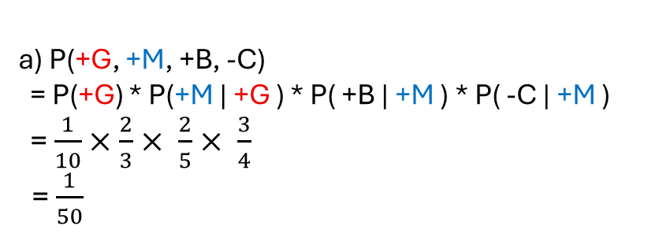



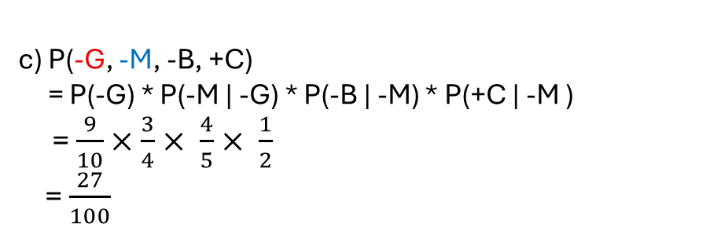
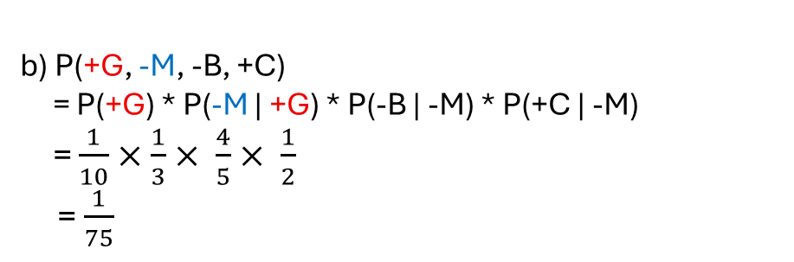


Questions 4
P(A, B, C, D) = P(A) * P(B | A) * P( C | B ) * P( D | B )
a) P(+G, +M, +B, -C)
= P(+G) * P(+M | +G ) * P( +B | +M ) * P( -C | +M )
= $\frac{1}{10}$ $×$ $\frac{2}{3}× \frac{2}{5}× \frac{3}{4}$
= $\frac{1}{50}$
b) P(+G, -M, -B, +C)
= P(+G) * P(-M | +G) * P(-B | -M) * P(+C | -M)
= $\frac{1}{10}$ $×$ $\frac{1}{3}× \frac{4}{5}× \frac{1}{2}$
= $\frac{1}{75}$
c) P(-G, -M, -B, +C)
= P(-G) * P(-M | -G) * P(-B | -M) * P(+C | -M )
= $\frac{9}{10}$ $×$ $\frac{3}{4}× \frac{4}{5}× \frac{1}{2}$
= $\frac{27}{100}$
= $×$ $\frac{}{}×\frac{}{}×\frac{}{}$
=

Slide 10
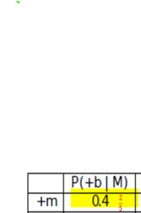
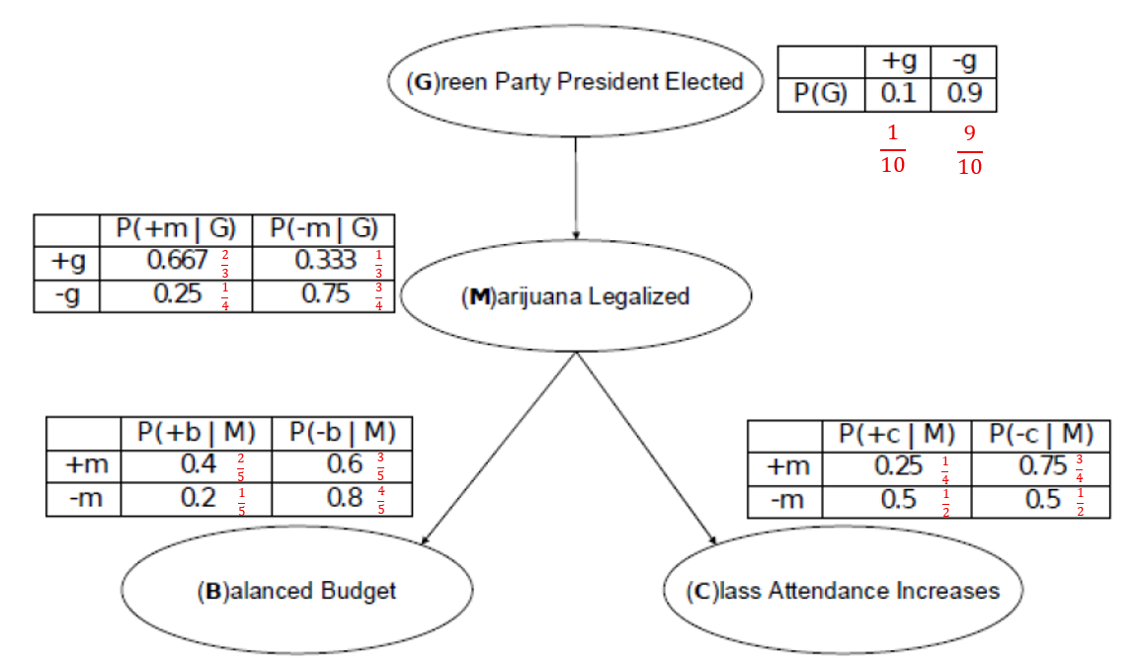

Questions 5
P(+b | +m)
=

Slide 11
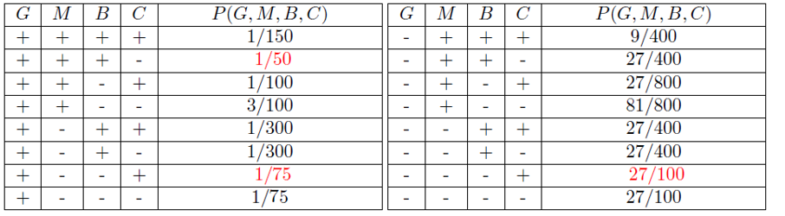




















Questions 5
Sum the joint probability that have +b
(b) P(+b)
= P(+G, +M, +B, +C) + P(+G, +M, +B, -C) + P(+G, -M, +B, +C) + P(+G, -M, +B, -C)
+ P(-G, +M, +B, +C) + P(-G, +M, +B, -C) + P(-G, -M, +B, +C) + P(-G, -M, +B, -C)
= $\frac{1}{150}$ $+$ $\frac{1}{50}+\frac{1}{300}+\frac{1}{300}+\frac{9}{400}+\frac{27}{400}+\frac{27}{400}+\frac{27}{400}$
= 8($\frac{1}{150})+24\left(\frac{1}{50}\right)+4\left(\frac{1}{300}\right)+4(\frac{1}{300}$)$+\text{3}(\frac{9}{400})$ $+$ 3$\left(\frac{27}{400}\right)+3\left(\frac{27}{400}\right)+3(\frac{27}{400})$
= $\frac{8}{1200}$ $+$ $\frac{24}{1200}+\frac{4}{1200}+\frac{4}{1200}$ $+ \frac{27}{1200}$ $+$ $\frac{81}{1200}+\frac{81}{1200}+\frac{81}{1200}$
= $\frac{31}{120}$
Transform all the denominators to the same value

Slide 12


















Questions 5
(b) P(+b)
= P(+G, +M, +B, +C) + P(+G, +M, +B, -C) + P(+G, -M, +B, +C) + P(+G, -M, +B, -C)
+ P(-G, +M, +B, +C) + P(-G, +M, +B, -C) + P(-G, -M, +B, +C) + P(-G, -M, +B, -C)
= $\frac{1}{150}$ $+$ $\frac{1}{50}+\frac{1}{300}+\frac{1}{300}+\frac{9}{400}+\frac{27}{400}+\frac{27}{400}+\frac{27}{400}$
= 8($\frac{1}{150})+24\left(\frac{1}{50}\right)+4\left(\frac{1}{300}\right)+4(\frac{1}{300}$)$+\text{3}(\frac{9}{400})$ $×$ 3$(\frac{27}{400})×3(\frac{27}{400})×3(\frac{27}{400})$
= $\frac{8}{1200}$ $+$ $\frac{24}{1200}+\frac{4}{1200}+\frac{4}{1200}$ $+ \frac{27}{1200}$ $+$ $\frac{81}{1200}+\frac{81}{1200}+\frac{81}{1200}$
= $\frac{31}{120}$
Transform all the denominators to the same value

Slide 13
















3) How to calculate Posterior Probability
1) Find posterior probability of P(A | B)
Given Information (Example with Random value):
P(B) = 0.50
P(A,B) = 0.20
$$\text{P}\text{(}\text{A}\text{ | }\text{B}\text{)}=\frac{\text{P}\text{(}\text{A} \text{,}\text{B}\text{)}}{\text{P}\text{(}\text{B}\text{)}}$$
$=\frac{\text{0.20}}{\text{0.50}}$
= 0.4

Slide 14



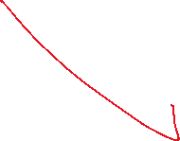






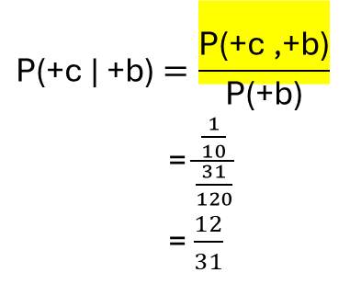
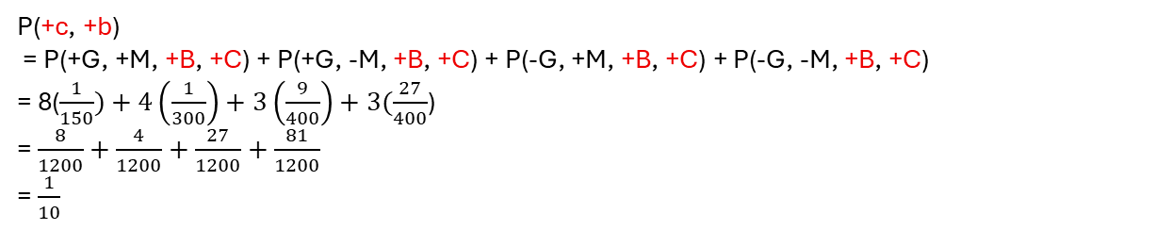







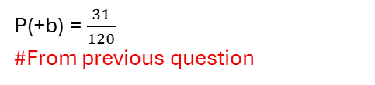

Questions 5
P(+b) = $\frac{31}{120}$
#From previous question
(c) P(+c | +b)
Marginal probability which is to sum up all the value P(+c,+b) Sum the joint probability that has +C & +B
We can’t use the multiplicative law here
$$\text{P}\text{(+}\text{c}\text{ | }\text{+}\text{b}\text{)}=\frac{\text{P}\text{(+}\text{c}\text{ ,}\text{+}\text{b}\text{)}}{\text{P}\text{(+}\text{b}\text{)}}$$
= $\frac{\frac{1}{10}}{\frac{31}{120}}$
= $\frac{12}{31}$
$$\text{P}\text{(+}\text{c}\text{, +}\text{b}\text{)}=P\left(+b \right|+c) ∗P(+c)$$
$\frac{1}{10}÷\frac{31}{120}$ = $\frac{12}{31}$
P(+c, +b)
= P(+G, +M, +B, +C) + P(+G, -M, +B, +C) + P(-G, +M, +B, +C) + P(-G, -M, +B, +C)
= 8($\frac{1}{150})+4\left(\frac{1}{300}\right)+3\left(\frac{9}{400}\right)+3(\frac{27}{400}$)
= $\frac{8}{1200}$ $+$ $\frac{4}{1200}+\frac{27}{1200}+\frac{81}{1200}$
= $\frac{1}{10}$

Slide 15
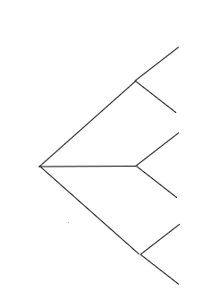
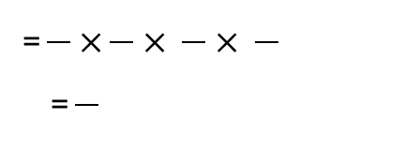
= $×$ $\frac{}{}× \frac{}{}× \frac{}{}$
=
0.90
T
P( T | C) = 0.90
C
0.01
0.10
T’
P( T’ | C) = 0.10
0.08
T
P( T | C’) = 0.08
0.99
C’
0.92
T’
P( T’ | C’) = 0.92

