Slide 1
Week 8 Lab Agenda
Question Discussion Sequence (3 > 1 > 2 > 4):
Begin with Question 3 first
Question-1
Question-2
Question-4

Slide 2

Basic/Theory of Probability
range of probability to be the real numbers from 0 to 1.Negative probabilities are not allowed [Lecture 8 – Slide 32]
Probability Values express in decimal fraction:
Percentage Expression | Decimal Expression
100% | 1.00 or 1
50% | 0.50
35% | 0.35
6% | 0.06
0% | 0.00 or 0

Slide 3





Joint Probability Notation
P(A ∩ B) can also be expressed as P(A,B)
Probability of Event A & B happened at the same time.
Probability that It Rain AND Sky is Dark
A = Rain
B = Sky is dark

Slide 4













Conditional Probability Notation
P(A | B)
Can be expressed as:
The probability that event A happens given that event B has already occurred
The probability that It Rain given that the Sky is Dark
Event B already happened/given
A = Rain
B = Sky is dark

Slide 5


Multiplicative Law
P(A ∩ B) = P(B | A) . P(A)
P(A ∩ B) = P(B | A) × P(A)
Reference:
1. Lecture 8 – Slide 32

Slide 6

1) How to calculate Joint Probability
1) Determine the joint probability of P(A , B)
Given (Random value):
P(A) = 0.20
P(B|A) = 0.50
P(A , B) = P(B | A) . P(A)
= 0.50 . 0.20
= 0.10

Slide 7
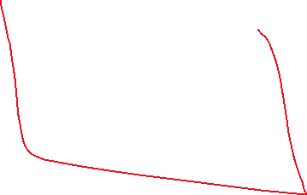
2) How to calculate Probability of an event
1) Calculate P(B)
Given Joint Probability (Example with Random value):
P(A,B) = 0.10
P(A,B’) = 0.20
P(A’,B) = 0.30
P(A’,B’) = 0.30
P(B) = P(A,B) + P(A’,B)
= 0.10 + 0.30
= 0.40
Marginal probability

Slide 8

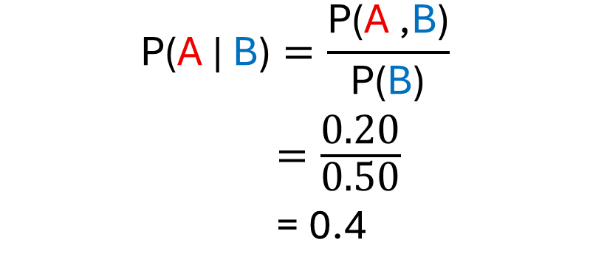

3) How to calculate Posterior Probability
1) Find posterior probability of P(A | B)
Given Information (Example with Random value):
P(B) = 0.50
P(A,B) = 0.20
$$\text{P}\text{(}\text{A}\text{ | }\text{B}\text{)}=\frac{\text{P}\text{(}\text{A} \text{,}\text{B}\text{)}}{\text{P}\text{(}\text{B}\text{)}}$$
$=\frac{\text{0.20}}{\text{0.50}}$
= 0.4

Slide 9

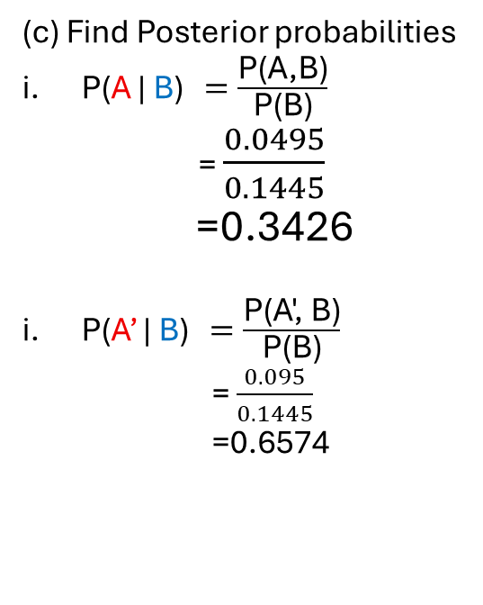




Questions 3
Step:
Extract Relevant Information from question
Draw tree representation
#Important information is provided in this question, so we don't need to do the above-mentioned steps.
3 OR 4 DECIMAL PLACE ANSWER
(a)
P(A,B) = P( B | A ) * P (A)
= 0.99 * 0.05
= 0.0495
P(A,B’) = P ( B’ | A ) * P(A) A
= 0.01 * 0.05
= 0.0005
P(A’,B) = P(B | A’) * P(A’)
= 0.10 * 0.95
= 0.095
P(A’,B’) = P(B’ | A’) * P(A’)
= 0.90 * 0.95
= 0.855
(b) Calculate P(B)
P(B) = P(A,B) + P(A’,B)
= 0.0495 + 0.095
= 0.1445
(c) Find Posterior probabilities
P(A | B) $=\frac{\text{P}\text{(}\text{A}\text{,}\text{B}\text{)}}{\text{P}\text{(}\text{B}\text{)}}$
= $\frac{0.0495}{0.1445}$
=0.3426
P(A’ | B) $=\frac{\text{P}\text{(}\text{A}\text{', }\text{B}\text{)}}{\text{P}\text{(}\text{B}\text{)}}$
= $\frac{0.095}{0.1445}$
=0.6574
$$\text{P}\text{(}\text{A}\text{ | }\text{B}\text{)}=\frac{\text{P}\text{(}\text{A} \text{,}\text{B}\text{)}}{\text{P}\text{(}\text{B}\text{)}}$$

Slide 10
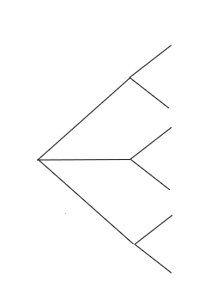




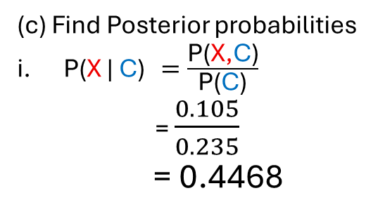


Questions 1
Step:
Extract Relevant Information from question
Draw tree representation
Given Info:
P(X) = 0.35
P(Y) = 0.35
P(Z) = 0.30
P( C | X) = 0.30
P( C | Y) = 0.20
P( C | Z) = 0.20
(a)
P(X,C) = P(C | X) * P(X)
= 0.30 * 0.35
= 0.105
P(Y,C) = 0.07
P(Z,C) = 0.06
P(X,C’) = 0.245
P(Y,C’) = 0.28
P(Z,C’) = 0.24
0.30
C
P(C| X) = 0.30
X
0.70
0.35
C’
P(C’| X) = 0.70
0.20
C
P(C| Y) = 0.20
(c) Find Posterior probabilities
P(X | C) $=\frac{\text{P}\text{(}\text{X}\text{,}\text{C}\text{)}}{\text{P}\text{(}\text{C}\text{)}}$
= $\frac{0.105}{0.235}$
= 0.4468
0.35
Y
0.80
C’
P(C’| Y) = 0.80
0.20
C
P(C| Z) = 0.20
0.0
0.30
Z
0.80
C’
P(C’| Z) = 0.80
Complete the rest of the question
Let C = Crash
C = Crash
C’ = No Crash
Find P(Crash)
P(C) = P(X,C) + P(Y,C) + P(Z,C)
= 0.235

Slide 11
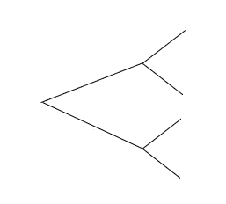






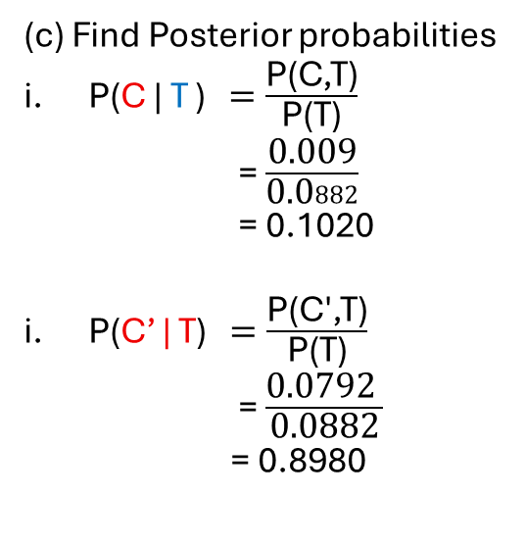






Questions 2
Step:
Extract Relevant Information from question
Draw tree representation
Given Info:
Let:
C = have cancer
C’ = no cancer
T = test positive on mammograms
T’ = test negative on mammograms
P(C) = 0.01, P(C’) = 0.99
P( T | C) = 0.90
P(T | C’) = 0.08
(a)
P(C,T) = P( T | C ) * P (C)
= 0.90 * 0.01
= 0.009
P(C,T’) = P(T’ | C) * P(C)
= 0.10 * 0.01
=0.001
P(C’,T) = P(T | C’) * P(C’)
= 0.08 * 0.99
= 0.0792
P(C’,T’) = P(T’ | C’) * P(C’)
= 0.92 * 0.99
=0.9108
Complete the rest of the question
Find P(T)
P(T) = P(C,T) + P(C’,T)
= 0.009 + 0.0792
=0.0882
(c) Find Posterior probabilities
P(C | T ) $=\frac{\text{P}\text{(}\text{C}\text{,}\text{T}\text{)}}{\text{P}\text{(}\text{T}\text{)}}$
= $\frac{\text{0.009}}{\text{0.0}882}$
= 0.1020
P(C’ | T) $=\frac{\text{P}\text{(}\text{C}\text{′,}\text{T}\text{)}}{\text{P}\text{(}\text{T}\text{)}}$
= $\frac{\text{0.0792} }{\text{0.0882}}$
= 0.8980
T
P(T |C) =0.90
0.90
C
0.01
0.10
T’
P(T’|C) = 0.10
T
0.08
P(T | C’) = 0.08
0.99
C’
0.92
T’
P( T’|C’) =0.92

Slide 12
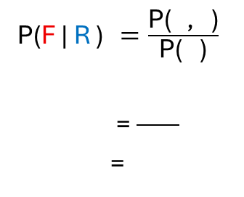



Questions 4
Step:
Extract Relevant Information from question
Draw tree representation
Given Info:
P(F | R ) $=\frac{\text{P}\text{(}\text{F}\text{,}\text{R}\text{)}}{\text{P}\text{(}\text{R}\text{)}}$
= $\frac{\text{0.}56}{0.59}$
= 0.9492
Let:
F = forecast is rain
F’ = forecast no rain
R = rain
R’ = no rain
P( R | F) = 0.80
P( R| F’ ) = 0.10
Fall/winter
P(F) = 0.70
Summer/Spring
P(F) = 0.20
b)
(a) Winter
Calculate Joint Probability:
P(F,R) = 0.56
P(F, R’) = 0.14
P(F’,R) = 0.03
P(F’,R’) = 0.27
0.80
R
P( R | F ) =0.80
F
0.70
0.20
R’
P(R’|F ) = 0.20
0.30
0.10
R
P(R|F’) = 0.10
F’
- We construct the joint probability using the information from the tree representation
- We need P(R) to calculate question B
0.90
R’
P( R’ |F’ ) = 0.90
Calculate P(R) = P( F| R) + P(F’|R)
= 0.56 + 0.03
= 0.59

Slide 13
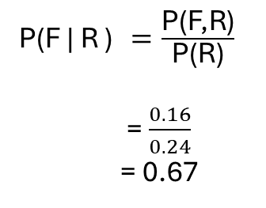
Questions 4
Step:
Extract Relevant Information from question
Draw tree representation
Given Info:
P(F | R ) $=\frac{\text{P}\text{(}\text{F}\text{,}\text{R}\text{)}}{\text{P}\text{(}\text{R}\text{)}}$
= $\frac{0.16}{0.24}$
= 0.67
Let:
F = forecast is rain
F’ = forecast no rain
R = rain
R’ = no rain
P( R | F) = 0.80
P( R | F’) = 0.10
Fall/Winter
P(F) = 0.70
Summer/Spring
P(F) = 0.20
d)
(C) Summer
Calculate Joint Probability:
P(F,R) = P(R|F) * P(F)
= 0.80 * 0.20
= 0.16
P(F, R’) = P( R’ | F ) * P(F)
= 0.20 * 0.20
= 0.04
P(F’,R) = P(R | F’) * P(F’)
= 0.10 * 0.80
=0.08
P(F’,R’) = P(R’ | F’) * P(F’)
= 0.90 * 0.80
= 0.72
0.80
R
P( R | F ) =0.80
F
Calculate P(R)
P(R) = P( F| R) + P(F’|R)
= 0.16 + 0.08
= 0.24
0.20
0.20
R’
P(R’|F ) = 0.20
0.80
0.10
R
P(R|F’) = 0.10
F’
0.90
R’
P( R’ |F’ ) = 0.90
- We construct the joint probability using the information from the tree representation
- We need P(R) to calculate question d

Slide 14
0.90
T
P( T | C) = 0.90
C
0.01
0.10
T’
P( T’ | C) = 0.10
0.08
T
P( T | C’) = 0.08
0.99
C’
0.92
T’
P( T’ | C’) = 0.92

