Slide 1
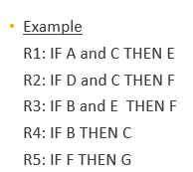

Forward Chaining
Fired Rules
R4 R1 R3 R5
Facts
A B C E F G
Forward chaining – reasoning from facts to the conclusions resulting from those facts – best for prognosis, monitoring, and control.

Slide 2



Backward Chaining
Proven Rules
R1 R3
Goal-driven approach
Goal:
Buy a car
Rules:
IF budget > RM20,000 THEN car
IF budget <= RM20,000 THEN motorcycle
IF long distance trip is important THEN car
Facts
User’s budget is RM30,000 Long distance trip is important
Backward chaining – reasoning in reverse from a hypothesis, a potential conclusion to be proved to the facts that support the hypothesis – best for diagnosis problems

Slide 3
Facts
User’s budget is RM40,000 Long distance trip is important

