Slide 1
Lab-11 Certainty Factor
Absolute Value
Certainty Theory : Value Interpretation
Single Premise Rule
Multiple Premises Rule
  Conjunctive Rules (AND) use min() function
  Disjunctive Rule (OR) use max() function
Min & Max Function
Similarly concluded rules (3 different scenario)

Slide 2
Absolute value
| A | = -5
= 5
A = -5
CF = -9
| CF | = -9
= 9

Slide 3
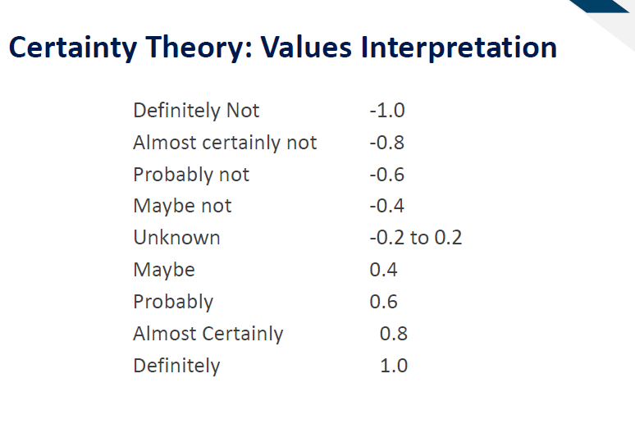
Lecture 11 – Slide 9

Slide 4
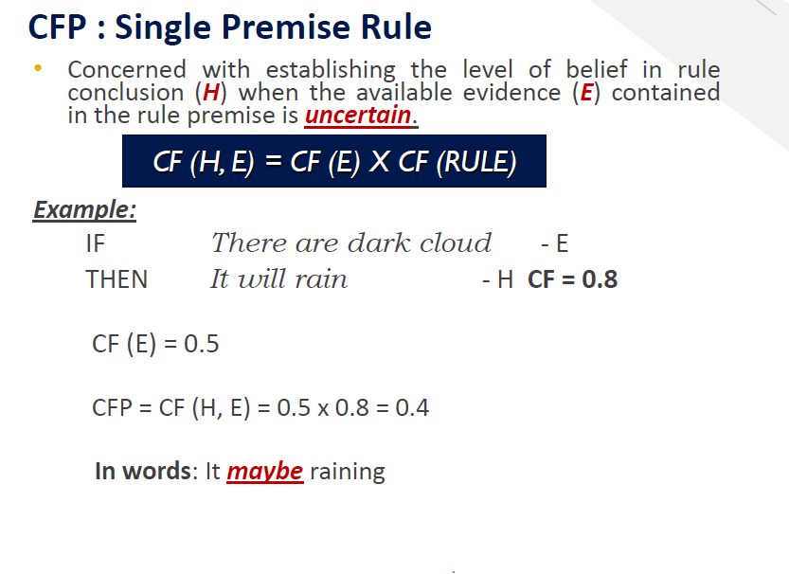


References: Lecture 11 – Slide 14

Slide 5
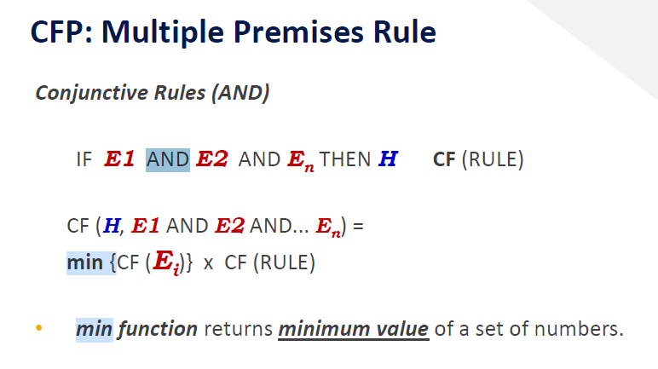
References: Lecture 11 – Slide 17

Slide 6
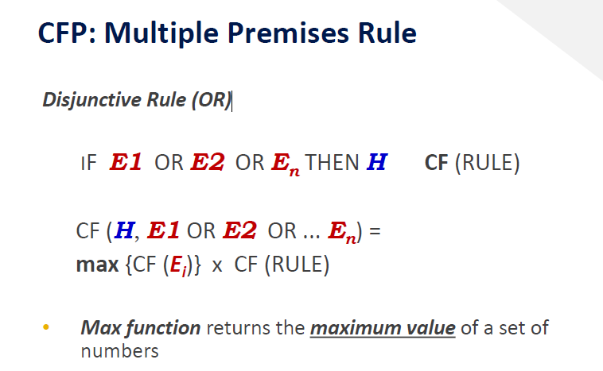
References: Lecture 11 – Slide 19

Slide 7
Min & Max Function
min() function returns minimum/smallest value of a set of number.
max() function returns maximum/largest value of a set of number.
min [3, 4]
= 3
max [3, 4]
= 4
References: Lecture 11 – Slide 17 & 19

Slide 8
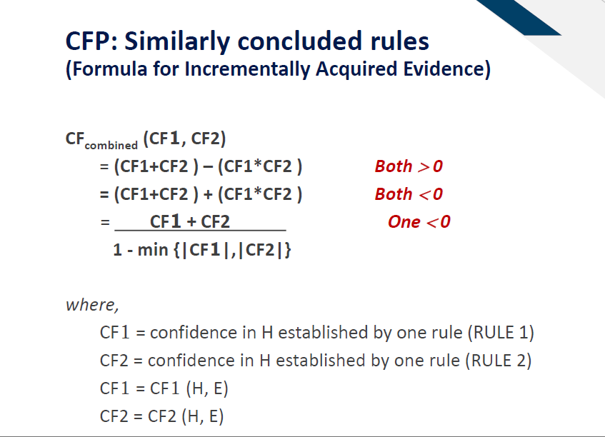
References: Lecture 11 – Slide 24

Slide 9
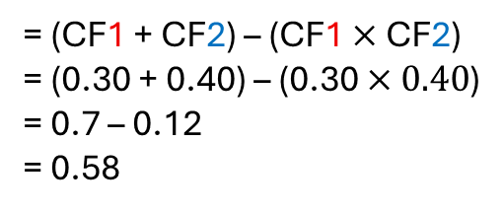
(Both value is Positive)
CF1 = 0.30
CF2 = 0.40
CFcombined (CF1, CF2)
= (CF1 + CF2) – (CF1 $×$ CF2)
= (0.30 + 0.40) – (0.30 $×0.40$)
= 0.7 – 0.12
= 0.58

Slide 10
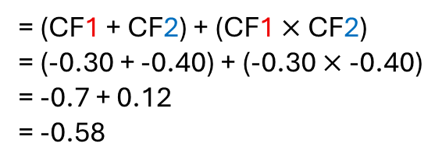
(Both value is Negative)
CF1 = -0.30
CF2 = -0.40
CFcombined (CF1, CF2)
= (CF1 + CF2) + (CF1 $×$ CF2)
= (-0.30 + -0.40) + (-0.30 $×\text{-0.}\text{4}\text{0}$)
= -0.7 + 0.12
= -0.58

Slide 11

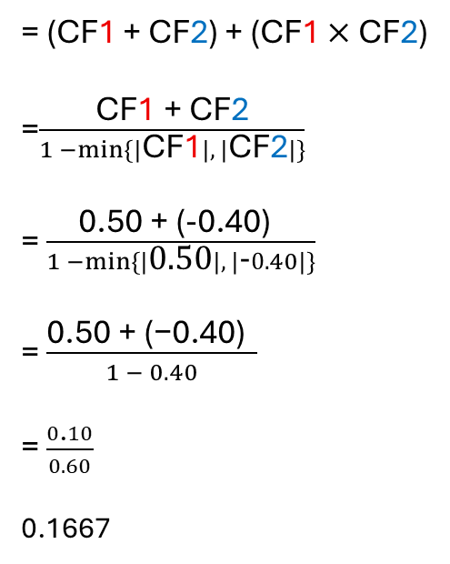

(one value is negative)
CF1 = 0.50
CF2 = -0.40
CFcombined (CF1, CF2)
= (CF1 + CF2) + (CF1 $×$ CF2)
=$\frac{\text{CF}\text{1}\text{ + }\text{CF}\text{2}}{1 −\min{\{|\text{CF}\text{1}|, |\text{CF}\text{2}|\}}}$
= $\frac{\text{0.50}\text{ +}\text{ (-}\text{0.}\text{4}\text{0}\text{)} }{1 −\min{\{|\text{0.50}|, |\text{-}0.40|\}}}$
= $\frac{\text{0.50 + (−}\text{0.}\text{4}\text{0}\text{)} }{1 − 0.40}$
= $\frac{0\text{.}10}{0.60}$
0.1667
Absolute Value
|-0.40|
= 0.40
0.40 is smallest value.

