Slide 1
Lab-11 Certainty Factor
Absolute Value
Certainty Theory : Value Interpretation
Single Premise Rule
Multiple Premises Rule
  Conjunctive Rules (AND) use min() function
  Disjunctive Rule (OR) use max() function
Min & Max Function
Similarly concluded rules (3 different scenario)

Slide 2
Absolute value
| A | = -5
= 5
A = -5
CF = -9
| CF | = -9
= 9

Slide 3
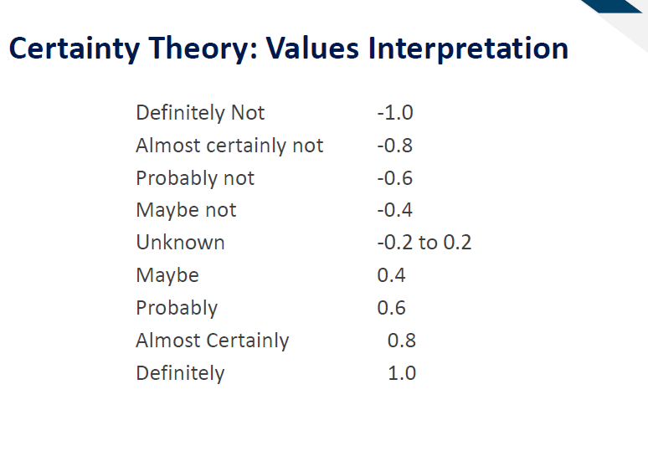
Lecture 11 – Slide 9

Slide 4
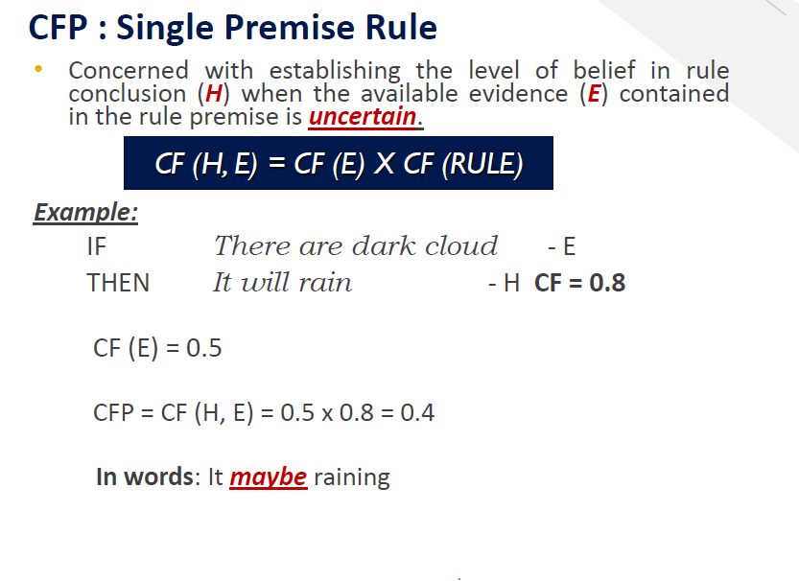


References: Lecture 11 – Slide 14

Slide 5
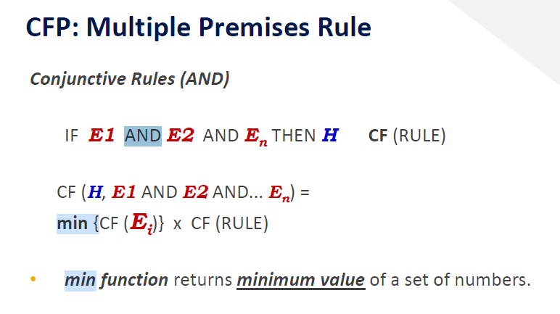
References: Lecture 11 – Slide 17

Slide 6
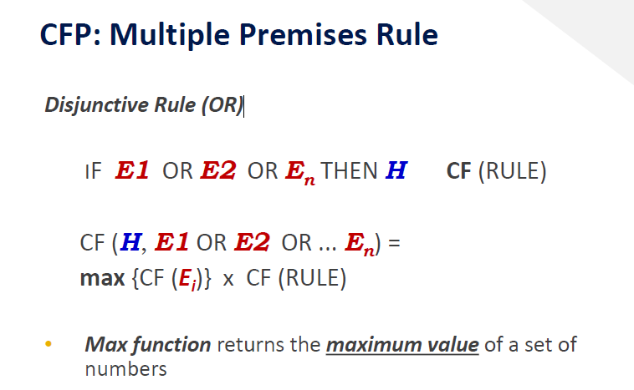
References: Lecture 11 – Slide 19

Slide 7
Min & Max Function
min() function returns minimum/smallest value of a set of number.
max() function returns maximum/largest value of a set of number.
min [3, 4]
= 3
max [3, 4]
= 4
References: Lecture 11 – Slide 17 & 19

Slide 8
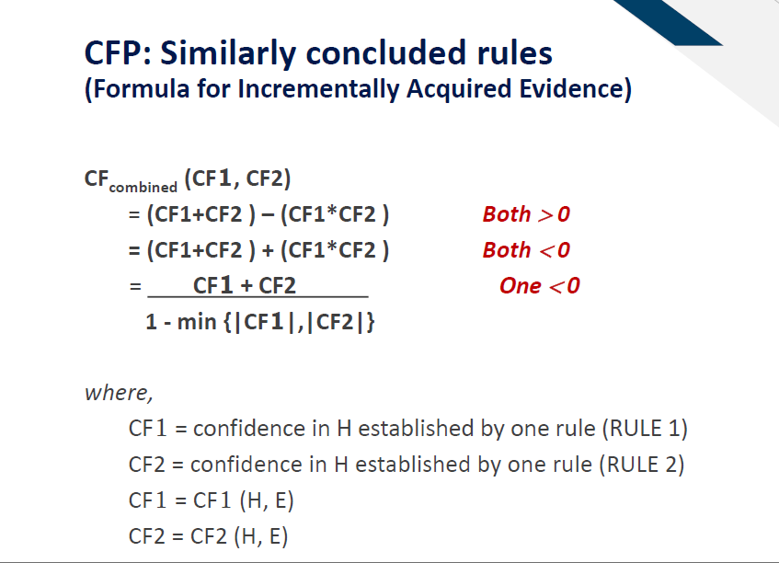
References: Lecture 11 – Slide 24

Slide 9
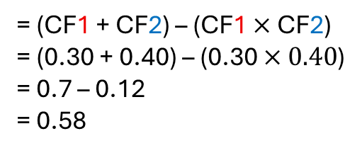
(Both value is Positive)
CF1 = 0.30
CF2 = 0.40
CFcombined (CF1, CF2)
= (CF1 + CF2) – (CF1 $×$ CF2)
= (0.30 + 0.40) – (0.30 $×0.40$)
= 0.7 – 0.12
= 0.58

Slide 10
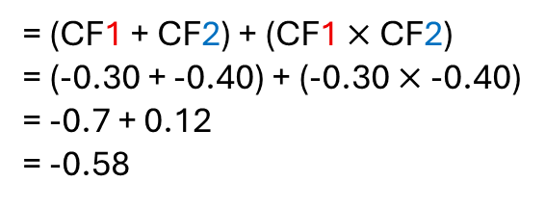
(Both value is Negative)
CF1 = -0.30
CF2 = -0.40
CFcombined (CF1, CF2)
= (CF1 + CF2) + (CF1 $×$ CF2)
= (-0.30 + -0.40) + (-0.30 $×\text{−0.}\text{4}\text{0}$)
= -0.7 + 0.12
= -0.58

Slide 11

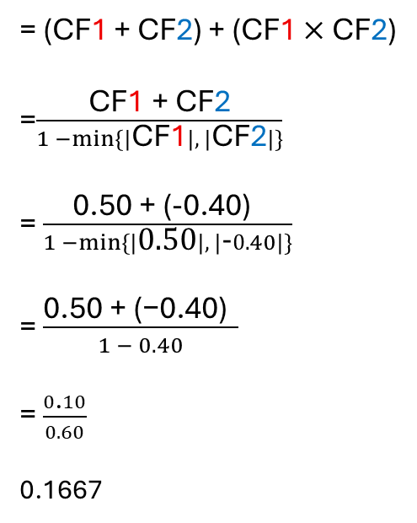

(one value is negative)
CF1 = 0.50
CF2 = -0.40
CFcombined (CF1, CF2)
= (CF1 + CF2) + (CF1 $×$ CF2)
=$\frac{\text{CF}\text{1}\text{ + }\text{CF}\text{2}}{1 −\min{\{|\text{CF}\text{1}|, |\text{CF}\text{2}|\}}}$
= $\frac{\text{0.50}\text{ +}\text{ (−}\text{0.}\text{4}\text{0}\text{)} }{1 −\min{\{|\text{0.50}|, |\text{−}0.40|\}}}$
= $\frac{\text{0.50 + (−0.40) } }{1 − 0.40}$
= $\frac{0\text{.}10}{0.60}$
0.1667
Absolute Value
|-0.40|
= 0.40
0.40 is smallest value.

Slide 12
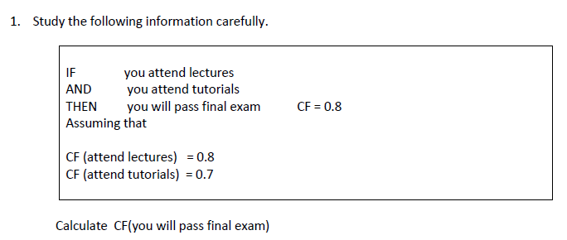
CF = min(0.8, 0.7) * 0.8
= 0.7 * 0.8
= 0.56

Slide 13
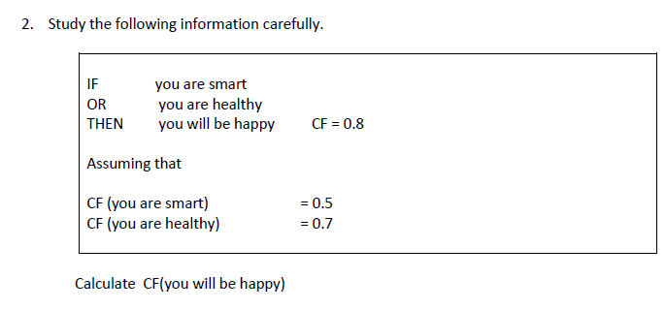
CF = max(0.5, 07) * 0.8
= 0.7 * 0.8
= 0.56

Slide 14
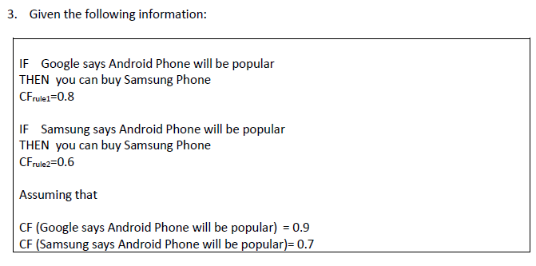

CFrule1(H,E1)
= 0.9 * 0.8
= 0.72
ii) CFrule2(H,E1)
= 0.7 * 0.6
=0.42
ii) CFrule2(H,E1)
= (CFrule1 + CFrule2) - (CFrule1 * CFrule2)
= 1.14 - 0.3024
= 0.8376
Given confirming evidence, the certainty for the Hypothesis to be true is increasing.

Slide 15
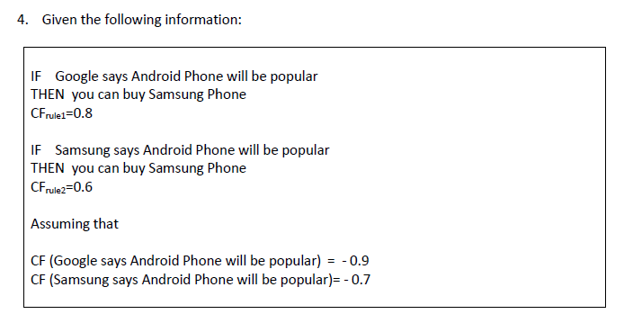
CFrule1(H,E1)
= -0.9 * 0.8
= -0.72
ii) CFrule2(H,E1)
= -0.7 * 0.6
= -0.42
ii) CFrule2(H,E1)
= (CFrule1 + CFrule2) + (CFrule1 * CFrule2)
= (-0.72 + (-0.42)) + (-0.72 * -0.42)
= -1.14 + 0.3024
= -0.8376
Given confirming evidence, the certainty for the Hypothesis to be true is decreasing.

Slide 16
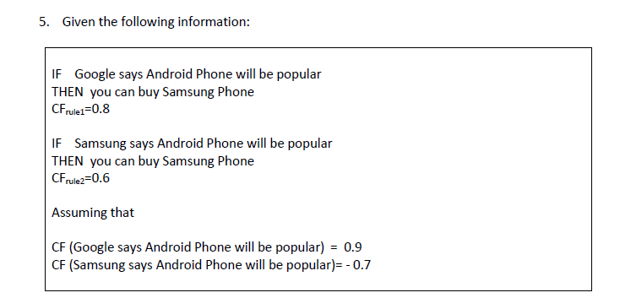
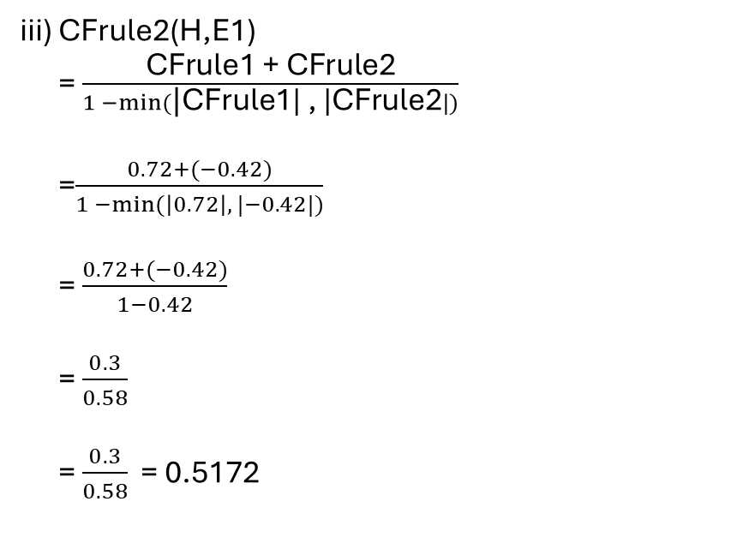
Given confirming evidence, the certainty for the Hypothesis to be true is increasing.
CFrule1(H,E1)
= 0.9 * 0.8
= 0.72
iii) CFrule2(H,E1)
= $\frac{\text{CFrule}\text{1 + }\text{CFrule}\text{2}}{1 −\min{(\text{|}\text{CFrule}\text{1| , |}\text{CFrule}\text{2}|)}}$
=$\frac{0.72+(−0.42)}{1 −min⁡(\left|0.72\right|, |−0.42|)}$
= $\frac{0.72+(−0.42)}{1−0.42}$
= $\frac{0.3}{0.58}$
= $\frac{0.3}{0.58}$ = 0.5172
ii) CFrule2(H,E1)
= -0.7 * 0.6
= -0.42

