Slide 1
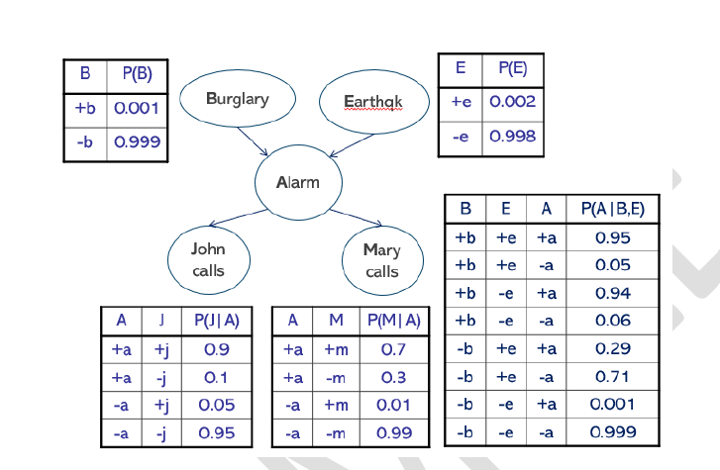


Calculate P(-j) using probabilistic reasoning
P(-j) = P(+a, -j) + P(-a, -j)
P(+a, -j) = P(-j | +a) * P(+a)
= 0.1 * ?
P(-a, -j) = P(-j | -a) * P(-a)
= 0.95 * ?
We need to find the value of P(+a) & P(-a) to calculate the join probability of:
P(+a, -j)
P(-a, -j)

Slide 2




Calculate P(-j) using probabilistic reasoning
P(-j) = P(+a, -j) + P(-a, -j)
= 0.000252 + 0.947606
= 0.947858
= 0.9479 (4 decimal place)
P(+a) = [ P(+a | +b, +e) * p(+b) * p(+e)] + [ P(+a | +b, -e) * p(+b) * p(-e)] + [ P(+a | -b, +e) * p(-b) * p(+e)] + [ P(+a | -b, -e) * p(-b) * p(-e)]
= [ 0.95 * 0.001 * 0.002 ] + [0.94 * 0.001 * 0.998] + [0.29 * 0.999 * 0.002] + [0.001 * 0.999 * 0.998]
= 0.0000019 + 0.00093812 + 0.00057942 + 0.000997002
= 0.002516442
= 0.00252 (Rounded to 5 decimal places)
P(+a, -j) = P(-j | +a) * P(+a)
= 0.1 * 0.00252
= 0.000252
P(-a, -j) = P(-j | -a) * P(-a)
= 0.95 * 0.99748
= 0.947606
P(+a) = 0.00252
P(-a) = 1 – P(+a)
= 1 - 0.00252
= 0.99748

Slide 3
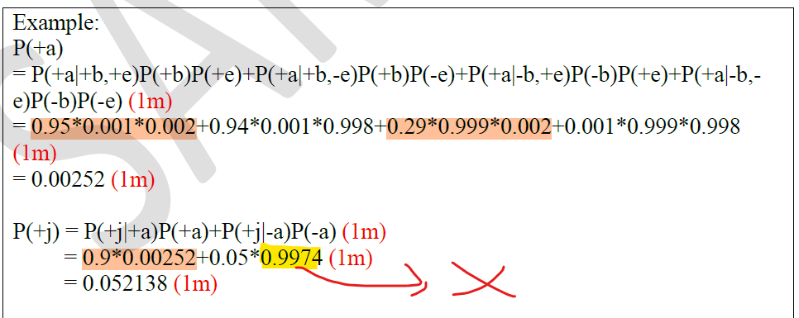



Calculate P(+j) using probabilistic reasoning
P(+j) = P(+a, +j) + P(-a, +j)
= 0.002268 + 0.049874
= 0.052142
P(+a) = [ P(+a | +b, +e) * p(+b) * p(+e)] + [ P(+a | +b, -e) * p(+b) * p(-e)] + [ P(+a | -b, +e) * p(-b) * p(+e)] + [ P(+a | -b, -e) * p(-b) * p(-e)]
= [ 0.95 * 0.001 * 0.002 ] + [0.94 * 0.001 * 0.998] + [0.29 * 0.999 * 0.002] + [0.001 * 0.999 * 0.998]
= 0.0000019 + 0.00093812 + 0.00057942 + 0.000997002
= 0.002516442
= 0.00252 (Rounded to 5 decimal places)
P(+a, +j) = P(+j | +a) * P(+a)
= 0.9 * 0.00252
= 0.002268
P(-a, +j) = P(+j | -a) * P(-a)
= 0.05 * 0.99748
= 0.049874
P(+a) = 0.00252
P(-a) = 1 – P(+a)
= 1 - 0.00252
= 0.99748

